Slide 1
F.F.F.P.U.

Slide 2
We all have that friend
Notes:
Who’s looking to get fit, get big, or whatever.

Slide 3
Introducing calorie counting
Count the calories of the food you eat
Involves looking up the individual caloric information of the food you are consuming
Unfortunately, also consumes a lot of your time to do so for each meal!

Slide 4
F.F.F.P.U.
F**king Fast Food Processor Unit
Message a picture of your food to the bot (which you probably already do with your friends)
Extracts the nutritional of each food in the image and keeps track of it
Currently supports calories and sodium

Slide 5
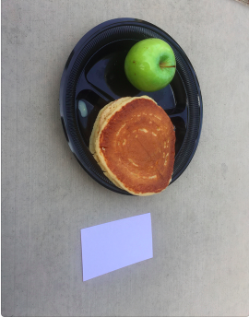
F.F.F.P.U. pipeline
TRANSFORMATION AND NORMALIZATION USING REFERENCE
SEGMENTS AND MASKS IMAGE USING CNNS INTO INDIVIDUAL FOODS
PASS CROPPED IMAGES OF FOOD INTO GOOGLE CLOUD PLATFORM FOR ANALYSIS
VOLUME ESTIMATION USING SCALED/NON-SCALED IMAGES
USE VOLUME + REGION CLASSIFICATION TO QUERY AND RETURN NUTRITIONAL INFO TO USER

Slide 6
DEMO

Slide 7
Future improvements
Expanding to other platforms like Messenger and Snapchat (people are incentivized to keep streak with bot).
Natural language processing to recognize user language for bot interactions.
Deterrents for exceeding caloric/sodium limits such as automatic donation to charities.
Faster and more accurate food recognition possible if we had time to better train the neural net.

